Slide 1
Case #4—EGFR-Mutant
Advanced NSCLC:
Evaluating Treatment Options
Francesco Grossi, MD
National Institute for Cancer Research
Genova, Italy
www.prIMEoncology.org

Slide 2


What would be your treatment approach for this patient with stage IV EGFR-mutant adenocarcinoma?
First-generation EGFR TKI (eg, erlotinib, gefitinib)
Second-generation EGFR TKI (afatinib)
Chemotherapy → EGFR TKI maintenance
Intercalated combination of chemo and erlotinib
Clinical trial of erlotinib + bevacizumab,
if available

Slide 3

Metastatic NSCLC:
ESMO Clinical Practice Guidelines for Diagnosis, Treatment, and Follow-Up
First-line treatment with a TKI (erlotinib, gefitinib, or afatinib) is the preferred treatment of patients with tumors bearing an activating (sensitising) EGFR mutation [I, A]
Patients with EGFR mutation and PS 3-4 may also be offered an EGFR TKI [II, A]
Reck M, et al. Ann Oncol. 2014;25 Suppl 3:iii27-iii39.

Slide 4
Clinical Efficacy of First Generation EGFR-TKIs vs Chemotherapy as First-Line Therapy
Trial | Pop. | Experimental Drug | EGFR Mut +, N | ORR, % TKI vs Chemo | PFS TKI vs Chemo, Months (HR, 95% CI)
IPASS | Asia | Gefitinib | 261 | 71.2 vs 47.3 | 9.8 vs 6.4 0.48 (0.36, 0.64)
First-SIGNAL | Asia | Gefinitib | 42 | 84.6 vs 37.5 | 8.4 vs 6.7 0.61 (0,31, 1.22)
WJTOG 3405 | Asia | Gefitinib | 172 | 62.1 vs 32.2 | 9.2 vs 6.3 0.49 (0.34, 0.71)
NEJGSG002 | Asia | Gefitinib | 224 | 73.7 vs 30.7 | 10.8 vs 5.4 0.32 (0.22, 0.41)
OPTIMAL | Asia | Erlotinib | 154 | 83 vs 36 | 13.7 vs 4.6 0.16 (0.10, 0.26)
EURTAC | Europe | Erlotinib | 174 | 58.1 vs 14.9 | 9.7 vs 5.2 0.37 (0.25, 0.54)
ORR, overall response rate
Mok T, et al. N Engl J Med. 2009;361(10):947-957. Han JY, et al. J Clin Oncol. 2012;30(10):1122-1128. Mitsudomi T, et al. Lancet Oncol. 2010;11(2):121-128. Maemondo M, et al. N Engl J Med. 2010;362(25):2380-2388. Zhou C, et al. Lancet Oncol. 2011;12(8):735-742. Rosell R, et al. Lancet Oncol. 2012;13(3): 239-246.

Slide 5
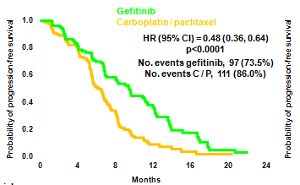
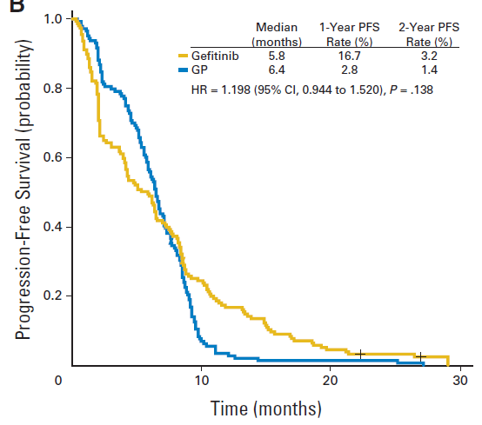
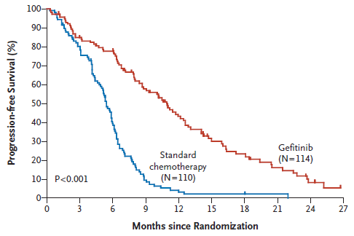
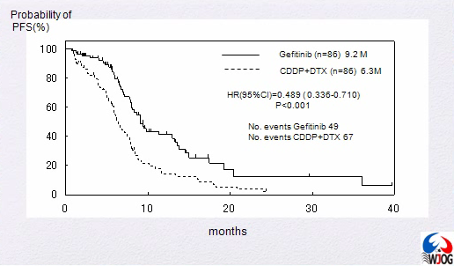
PFS in Phase III Trial With Gefitinib in EGFR Mut+ NSCLC
P<.0001
Median PFS, gefitinib vs CT
10.8 months vs. 5.4 months
HR = 0.30 (95% CI, 0.22 to 0.41)
P<.001
Mok T, et al. N Engl J Med. 2009;361(10):947-957. Han JY, et al. J Clin Oncol. 2012;30(10):1122-1128. Maemondo M, et al. N Engl J Med. 2010;362(25):2380-2388. Mitsudomi T, et al. Lancet Oncol. 2010;11(2):121-128.

Slide 6
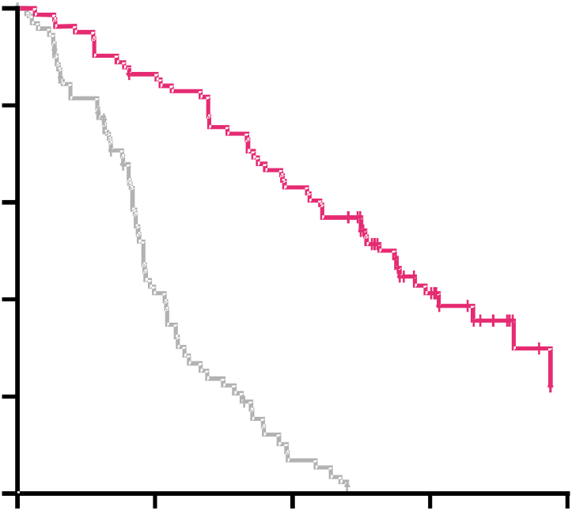
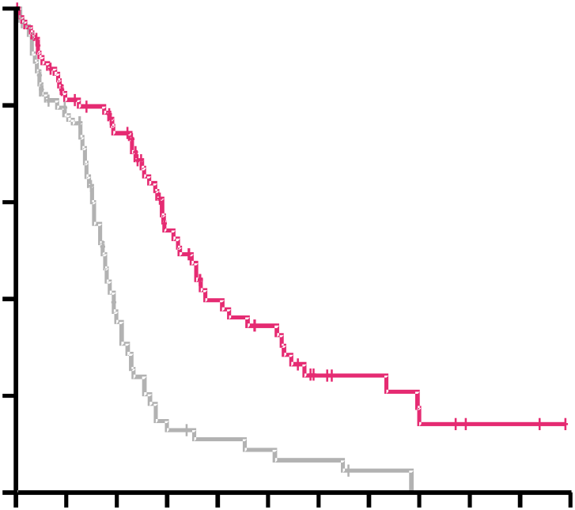
PFS in Phase III Trial With Erlotinib in
EGFR Mut+ NSCLC
Asian Patients
(OPTIMAL study)¹
Caucasian Patients
(EURTAC study)²
1.0
0.8
0.6
0.4
0.2
0
1.0
0.8
0.6
0.4
0.2
0
Erlotinib (n = 82)
Gem/carbo (n = 72)
Erlotinib (n = 86)
Chemotherapy (n = 87)
HR = 0.16 (0.10-0.26)
Log-rank P<.0001
HR = 0.37 (0.25-0.54)
Log-rank P<.0001
PFS Probability
PFS Probability
4.6
13.1
5.2
9.7
0 5 10 15 20
0 3 6 9 12 15 18 21 24 27 30 33
Time, months
Time, months
Pivotal phase III EURTAC study resulted in
erlotinib first-line EGFR Mut+ label (EU)
1. Zhou C, et al. Lancet Oncol. 2011;12(8):735-742. 2. Rosell R, et al. Lancet Oncol. 2012;13(3):239-246.

Slide 7
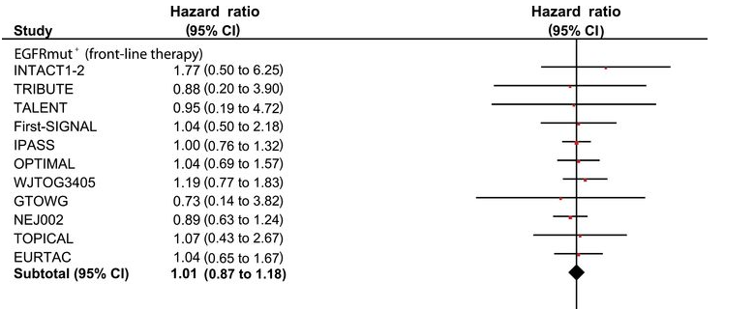
First-Line EGFR-TKI
Does Not Result in Improved OS
Lee CK, et al. J Natl Cancer Inst. 2013;105(9):595-605.

Slide 8
LUX-Lung 3 and 6 Phase III Trials
Stage IIIB (wet)/IV lung adenocarcinoma, with EGFR mutation in tumor
(central lab testing; Therascreen® EGFR29ª RGQ PCR)
Randomisation 2:1
Stratified by EGFR mutation (Del19/L858R/other)
LUX-Lung 3¹
(n = 345)
LUX-Lung 6²
(n = 364; Asian patients)
Cisplatin + Pemetrexed
75 mg/m² + 500 mg/m²
IV q21d, up to 6 cycles
Afatinib
40 mg/d^{b}
Gemcitabine + Cisplatin
1000 mg/m² D1, D8 + 75 mg/m²
IV q21d, up to 6 cycles
Primary endpoint: PFS (RECIST 1.1, independent review)^{c}
Secondary endpoints: ORR, DCR, DOR, tumor shrinkage, OS, PRO,^{d} safety
RESIST, Response Evaluation Criteria in Solid Tumours; DOR, duration of response; OS, overall survival; PRO, patient-reported outcomes.
ªEGFR29:19 deletions in exon 19, 3 insertions in exon 20, L858R, L861Q, T790M, G719S, G719A, and G719C (or G719X), S768I.
^{b}Dose escalated to 50 mg if limited AE observed in cycle 1. Dose reduced by 10 mg decrements in case of related G3 or prolonged G2 AE.
^{c}Tumour assessments: q6wk until week 48 and q12wk thereafter until progression/start of new therapy.
^{d}EQ-5D, EORTC QLQ-C30 and QLQ-LC13 at randomisation and q3wk until progression or new anticancer therapy.
1. Sequist LV, et al. J Clin Oncol. 2013;31(27):3327-3334. 2. Wu YL, et al. Lancet Oncol. 2014;15(2):213-222.

Slide 9
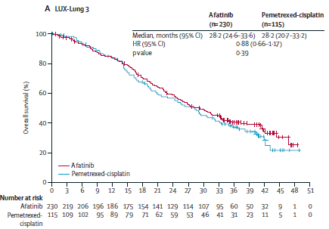
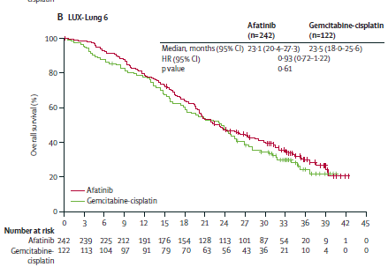
Lux Lung 3 and 6: Overall Survival
Yang JC, et al. Lancet Oncol. 2015;16(2):141-151.

Slide 10
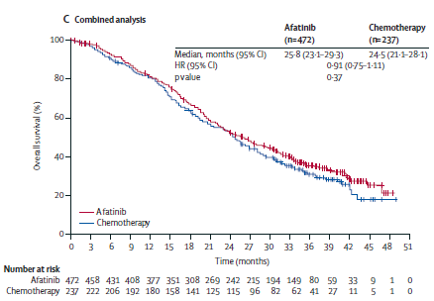
Lux Lung 3 and 6: Overall Survival
Yang JC, et al. Lancet Oncol. 2015;16(2):141-151.

Slide 11
LUX-Lung 3 and 6 Exploratory Combined OS Analysis: Del19 and L858R
Del19
L858R
1.0
1.0
0.8
Afatinib
Chemotherapy
0.8
Afatinib
Chemotherapy
0.6
0.6
Estimated OS probability
Estimated OS probability
0.4
0.4
0.2
0.2
No. at risk:
Afatinib 40 236 230 223 217 202 192 173 160 145 131 117 90 50 38 22 6 1 0
Chemotherapy 119 113 103 95 87 72 63 55 51 43 38 27 14 9 1 1 0 0
No. at risk:
Afatinib 40 183 181 167 154 141 128 111 91 80 70 64 51 27 20 11 3 0 0
Chemotherapy 93 86 82 78 75 69 61 55 50 40 32 25 20 14 9 4 1 0
0.0
0.0
0
3
6
9
12
15
18
21
24
27
30
33
36
39
42
45
48
51
0
3
6
9
12
15
18
21
24
27
30
33
36
39
42
45
48
51
Time of overall survival (months)
Time of overall survival (months)
 | Del19 |  | L858R
 | Afatinib (n=236) | Chemo (n=119) | Afatinib (n=183) | Chemo (n=93)
Median, months | 31.7 | 20.7 | 22.1 | 26.9
HR (95% CI), P-value | 0.59 (0.45-0.77), P=.0001 |  | 1.25 (0.92-1.71), P=.1600
Yang JC, et al. Lancet Oncol. 2015;16(2):141-151.

Slide 12
LUX-Lung 3, EURTAC, IPASS: Safety
 | % of Patients
 | LUX-Lung 3¹ | EURTAC² | IPASS³
 | Afatinib | Erlotinib | Gefitinib
 | (n = 229) | (n = 84) | (n = 607)
Adverse Events | Grade ≥3 | Grade ≥3 | Grade ≥3
Diarrhea | 14.4 | 5 | 3.8
Rash/acneª | 16.2 | 13 | 3.1
Stomatitis/mucositisª | 8.7 | NR | 0.2
Paronychia | 11.4 | NR | 0.3
ªGroup term in at least 1 of the trials included in the table. NR, not reported
1. Sequist LV, et al. J Clin Oncol. 2013;31(27):3327-3334. 2. Rosell R, et al. Lancet Oncol. 2012;13(3):239-246.
3. Mok TS, et al. N Engl J Med. 2009;361(10):947-957.

Slide 13
LUX-Lung 3, EURTAC, IPASS
Safety (Drug Discontinuation)
 | % of Patients
 | LUX-Lung 3¹ Afatinib (n = 229) | EURTAC² Erlotinib (n = 84) | IPASS³ Gefitinib (n = 607)
Treatment-related AEs | 99.6 | 93 | NR
Any grade ≥3 | 60.7 | 45 | 28.7
Dose reduction due to AE | 57.2 | 21 | 16.1 (modification)
Discontinuation due to AE | 7.9 (related) | 6 (related) | 6.9
Any serious AE | 28.8 | 32 | 16.3
Fatal serious AE | 1.7 (related) | 1 (related) | 3.8
ILD-like | 1.3 | 1 | 2.6
1. Sequist LV, et al. J Clin Oncol. 2013;31(27):3327-3334. 2. Rosell R, et al. Lancet Oncol. 2012;13(3):239-246.
3. Mok TS, et al. N Engl J Med. 2009;361(10):947-957.
ILD, interstitial lung disease

Slide 14




Second or First Generation TKI?
LUX Lung 7 Randomized Phase IIb Study
Is afatinib better than gefitinib in patients with EGFR mutation?
R
A
N
D
O
M
I
Z
E
Afatinib 40 mg qd
Advanced NSCLC
Adenocarcinoma
EGFR mut+
First-line treatment
PS 0-1
1
1
Gefitinib 250 mg qd
N = 264 patients
Sample size increased
to 319
Accrual completed!
National Institutes of Health. Available at: https://clinicaltrials.gov/ct2/show/NCT01466660. Accessed 4 March 2015.

Slide 15
How to Improve Outcome?
  Chemotherapy → EGFR TKI maintenance
  Intercalating: FASTACT 2
  Adding bevacizumab

Slide 16
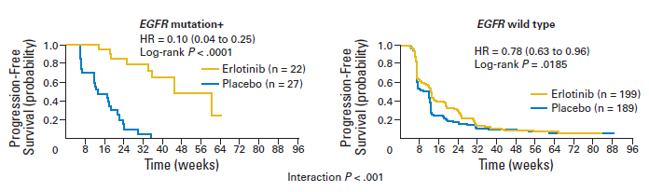
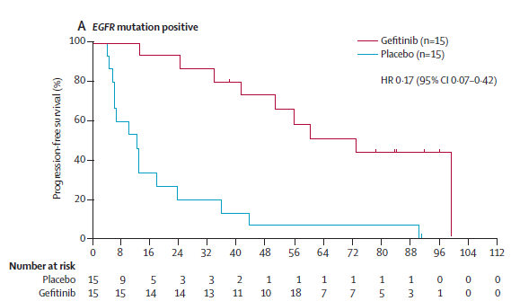
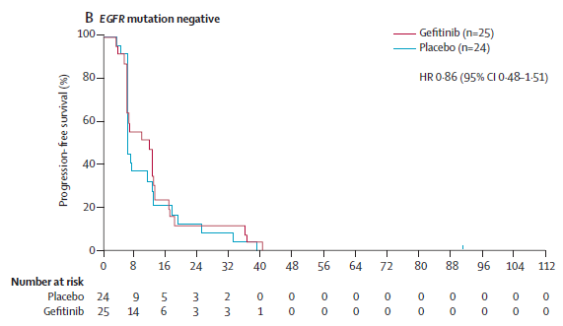
Switch Maintenance in NSCLC:
Bio-SATURN and INFORM
Brugger W, et al. J Clin Oncol. 2011;29(31):4113-4120. Zhang L, et al. Lancet Oncol. 2012;13(5):466-475.

Slide 17
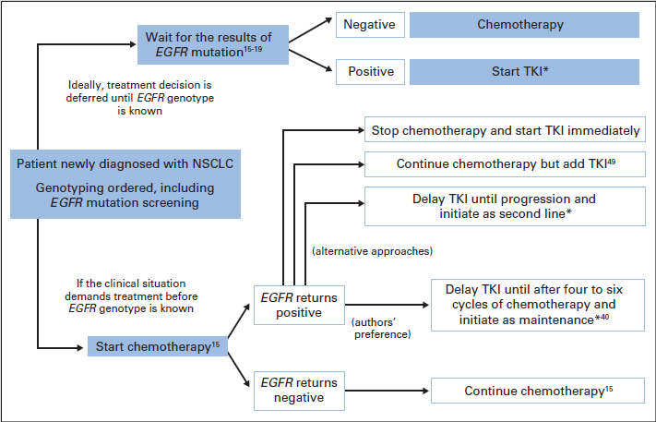
Timing of EGFR TKI Therapy in Patients
With EGFR Mutation
Moran T, et al. J Clin Oncol. 2012;30(27):3330-3336.

Slide 18
FASTACT-2: PFS and OS Benefit With Intercalated Erlotinib in EGFR Mut+ Disease
(N = 97)
PFS
OS
1.0
1.0
GC-erlotinib (n = 49)
GC-erlotinib (n = 49)
GC-placebo (n = 48)
GC-placebo (n = 48)
0.8
HR = 0.25 (0.16-0.39)
P<.0001
0.8
HR = 0.48 (0.27-0.84)
P = .0092
0.6
6.9
16.8
0.6
20.6
31.4
PFS Probability
OS probability
0.4
0.4
0.2
0.2
0
0
0
4
8
12
16
20
24
28
32
0
4
8
12
16
20
24
28
32
36
Time, Months
Time, Months
OS benefit with GC-erlotinib vs GC-placebo despite high rate of crossover (85%) from GC-placebo to second-line EGFR TKI
GC, gemcitabine, platinum
Wu YL, et al. Lancet Oncol. 2013;14(8):777-786.

Slide 19
Adding Bevacizumab?
JO25567 Trial
Stage IIIB/IV or recurrent NSCLC
Nonsquamous histology
EGFR Mut+
  Exon 19 deletion / L858R*
No prior treatment
ECOG PS 0-1
(n = 150)
Bevacizumab 15 mg/kg IV q3w + erlotinib 150 mg/day
PD
R
Stratified by: Gender, stage,
smoking status, EGFR mut type
1:1
Erlotinib 150 mg/day
PD
Primary endpoint
PFS by independent review
Secondary endpoints
OS
ORR
DCR
Response duration
QoL
Safety
Exploratory endpoints
Biomarkers
Kato T, et al. J Clin Oncol. 2014;32(5s): Abstract 8005.

Slide 20
Prolonged PFS When Bevacizumab Is Added to Erlotinib
1.0
Bevacizumab + erlotinib
Erlotinib
0.8
PFS by EGFR Mutation Type, months
 | EB | E
Exon 19 deletion | 18.0 | 10.3
Exon 21 L858R | 13.9 | 7.1
0.6
PFS Probability
0.4
HR 0.54 (0.36-0.79)
Log-rank P<.0015
0.2
9.7
9.7
16.0
0
0
6
12
18
24
Time, Months
RESULTS of BELIEF Trial AWAITED!
Kato T, et al. J Clin Oncol. 2014;32(5s): Abstract 8005.

Slide 21
After 11 Months: Slight progression/asymptomatic
Which of the following would you recommend now?
Continue erlotinib and perform close follow-up
Local radiotherapy and continue erlotinib
Change to second generation TKI
Continue erlotinib and add platinum-based chemotherapy
Discontinue erlotinib and start platinum-based chemotherapy
Clinical trial of afatinib + cetuximab
Rebiopsy to determine the type of resistance
and include patient in a clinical trial with a
third generation TKI

Slide 22

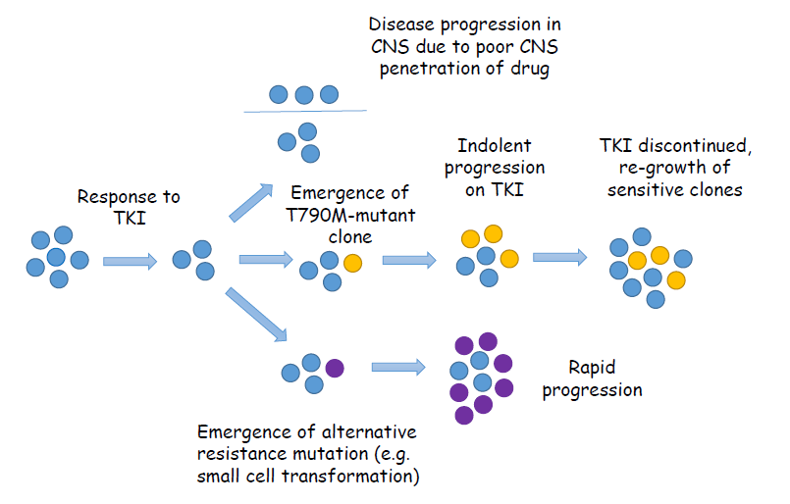



PD After Response to TKI in Patients With
EGFR Mutations
Disease progression in CNS due to poor CNS penetration of drug
Indolent progression on TKI
TKI discontinued regrowth of sensitive clones
Response to TKI
Emergence of T790M-mutant clone
Rapid progression
Emergence of alternative resistance mutation (eg, small cell transformation)
Sacher AG, et al. Cancer. 2014;120(15):2289-2298

Slide 23
ASPIRATION: Study Design
Erlotinib
Erlotinib
Stage IV or recurrent NSCLC
Chemonaïve
EGFR Mut+ NSCLC*
  exon 18-21
ECOG PS 0-2 (n = 207)
PD by
RECIST 1.1
PD
by physician
assessment
PFS1
PFS2
* Except for T790M
Primary endpoint
PFS1 (time to RECIST
PD or death)
Secondary endpoints
PFS2 (time to off-erlotinib PD if erlotinib was extended beyond RECIST PD)
OS
ORR/DCR/BOR
Safety
Park K, et al. Ann Oncol. 2014;25(Suppl 4): Abstract 1223O.

Slide 24
ASPIRATION: PFS in Patients Receiving Erlotinib Post-PD (n = 93/207)
1.0
PFS1
PFS2
0.8
0.6
PFS Estimate
0.4
0.2
0
11.0
14.1
0
6
12
18
24
30
Time, Months
The difference between PFS1 and PFS2 was an additional 3.1 months
Park K, et al. Ann Oncol. 2014;25(Suppl 4): Abstract 1223O.

Slide 25
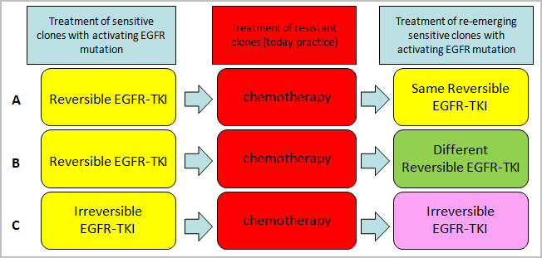
Strategies in Patients With EGFR Mutation After First-Line EGFR-TKI
A
B
C

Slide 26
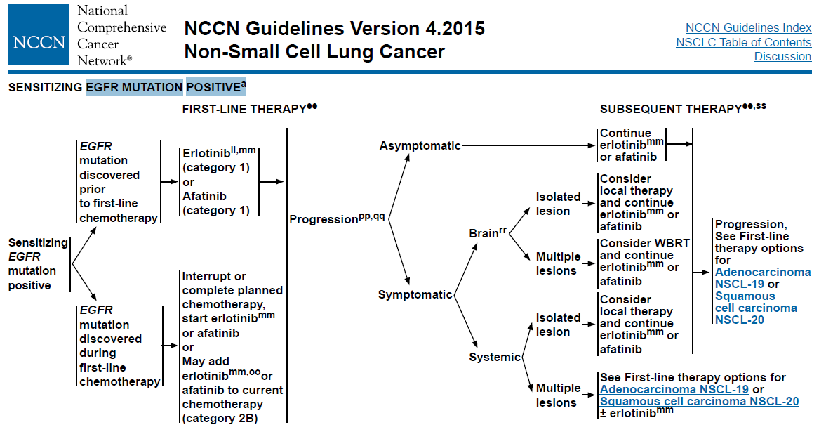
Strategies in Patients With EGFR Mutation After First-Line EGFR-TKI
National Comprehensive Cancer Network. http://www.nccn.org/professionals/physician_gls/pdf/nscl.pdf. Accessed 11 March 2015.

Slide 27
IMPRESS: Study Design
27
Patients
Age ≥18 years (≥20 years in Japan)
WHO PS 0-1
Histologically confirmed stage IIIB/IV EGFR mut+ advacned NSCLC
Chemotherapy-naïve
Achieved CR/PR
≥4 months or SD
>6 months with
first-line gefitinib
Disease progression (RECIST)ª <4 weeks prior to study randomisation
Cisplatin 75 mg/m²
+
Pemetrexed
500 mg/m² (≤6 cycles)
+
Gefitinib 250 mg
Endpoints
Primary
PFS
Secondary
OS
ORR
Disease control rate
Safety and tolerability
Health-related QoL^{c}
Exploratory
Biomarkers^{d}
1:1 randomization^{b}
Cisplatin 75 mg/m² IV
+
Pemetrexed
500 mg/m² IV
(≤6 cycles)
+
Placebo 250 mg
ª Progressive disease based on radiologic evaluation (modified Jackman’s criteria¹) and RECIST v 1.1. Tumor assessments were performed ≤4 weeks before the start of treatment (baseline), and every 6 weeks (±7 days) after randomization until progressive disease;
^{b} Randomization did not include stratification factors; analyses were adjusted for 2 covarietes; age (<64 years vs ≥65 years) and prior response to gefitinib (SD vs PR+CR)
^{c} will be reported seperately
^{d} Analyses not yet completed and will be reported seperately
Mok T, et al. Ann Oncol. 2014;25(Suppl 4): Abstract LBA2_PR.

Slide 28
IMPRESS: PFS and OS
PFS
OS (33% of events)
1.0
0.8
0.6
0.4
0.2
0
 | Gefitinib (n = 133) | Placebo (n = 132)
Median PFS, months | 5.4 | 5.4
Number of events, n (%) | 98 (73.7) | 107 (81.1)
1.0
0.8
0.6
0.4
0.2
0
 | Gefitinib (n = 133) | Placebo (n = 132)
Median OS, months | 14.8 | 17.2
Number of events, n (%) | 50 (37.6) | 37 (28.0)
HRª (95% CI) 0.86 (0.65, 1.13)
P = .273
HRª (95% CI) 1.62 (1.05, 2.52)
P = .029
Probability of PFS
Probability of OS
Placebo
Gefitinib
Gefitinib
Placebo
0 2 4 6 8 10 12 14
0 2 4 6 8 10 12 14 16 18 20 22 24 26
Time of Randomization, Months
Time of Randomization, Months
Patients at risk
Gefitinib 133 110 88 40 25 12 6 0
Placebo 132 100 85 39 17 5 4 0
Patients at risk
Gefitinib 133 125 111 88 64 43 27 19 12 8 4 2 0 0
Placebo 132 129 119 94 76 55 39 27 16 10 7 4 2 0
ªPrimary Cox analysis with covariates
Mok T, et al. Ann Oncol. 2014;25(Suppl 4): Abstract LBA2_PR.

Slide 29
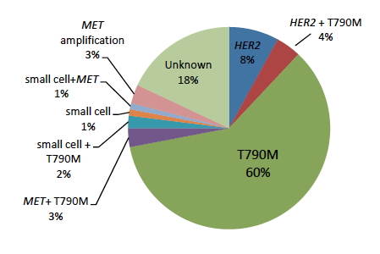
Resistance Mutations
Yu HA, et al. Clin Cancer Res. 2013;19(8):2240-2247.

Slide 30
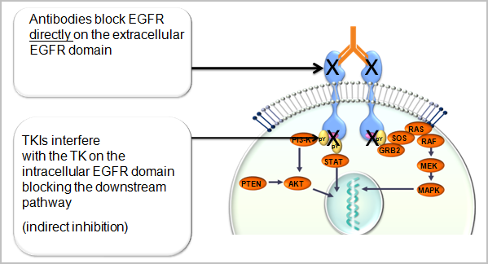
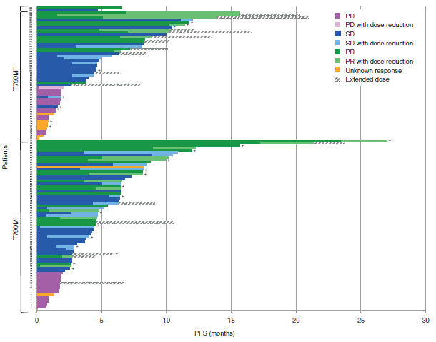
Afatinib + Cetuximab: Response and PFS by T790M Mutation Status
71 patients with proven EGFR T790M mutation:
confirmed RR = 32%
PFS 4.7 months
Grade 3/4 AEs 44%
Janjigian YY, et al. Cancer Discov. 2014;4(9):1036-1045

Slide 31

EGFR Inhibitors Following PD on EGFR-Directed Therapy
 | RR T790M+ | RR T790M- | PFS
Afatinib/cetuximab | 32% | 25% | 4.7
HM-61713 | 29% | 12% | 4.34
CO-1686 (rociletinib) | 58% | Inc | ↑
AZD 9291 | 65% | 22% | ↑
1.Janjigian YY, et al. Cancer Discov. 2014;4(9):1036-1045; 2. Kim DW, et al. J Clin Oncol 2014;32 (suppl; abstr 8011);
3. Sequist L, et al J Clin Oncol 2014; 32:(suppl; abstr 8010^); 4 Janne PA, J Clin Oncol 2014;32 (suppl; abstr 8009^);

Slide 32
20 refractory after TKI failure, 1 naïve EGFR Mut+ patients; ORR 19%
PFS and OS in EGFR+ NSCLC Treated With Nivolumab Plus Erlotinib
PFS
OS
10
0
Nivolumab 3 mg/kg + erlotinib
(mPFS 29.4 wks)
10
0
Nivolumab 3 mg/kg + erlotinib
(mOS NR)
8
0
8
0
18-month OS rate = 64%
6
0
PFS rate at 24 weeks = 50%
6
0
PFS (%)
OS (%)
4
0
4
0
2
0
2
0
0
0
B/L
1
2
2
4
3
6
4
8
6
0
7
2
8
4
9
6
B/L
1
2
2
4
3
6
4
8
6
0
7
2
8
4
9
6
10
8
Time Since First Dose (Weeks)
Time Since First Dose (Weeks)
Number of Pts at Risk
Number of Pts at Risk
Nivolumab +
Nivolumab +
erlotinib
2
1
1
4
9
7
7
4
3
1
0
erlotinib
2
1
2
0
2
0
1
6
1
5
1
5
1
3
1
0
1
0
2
Gettinger S, et al. Presented at: 2014 Chicago Multidisciplinary Symposium in Thoracic Oncology; 30 October -
1 November 2014; Chicago, Illinois. Abstract 171.

Slide 33
20 refractory after TKI failure, 1 naïve EGFR Mut+ patients; ORR 19%
PFS and OS in EGFR+ NSCLC Treated With Nivolumab Plus Erlotinib
PFS
OS
10
0
Nivolumab 3 mg/kg + erlotinib
(mPFS 29.4 wks)
10
0
Nivolumab 3 mg/kg + erlotinib
(mOS NR)
8
0
8
0
18-month OS rate = 64%
6
0
PFS rate at 24 weeks = 50%
6
0
PFS (%)
OS (%)
4
0
4
0
2
0
2
0
0
0
B/L
1
2
2
4
3
6
4
8
6
0
7
2
8
4
9
6
B/L
1
2
2
4
3
6
4
8
6
0
7
2
8
4
9
6
10
8
Time Since First Dose (Weeks)
Time Since First Dose (Weeks)
Number of Pts at Risk
Number of Pts at Risk
Nivolumab +
Nivolumab +
erlotinib
2
1
1
4
9
7
7
4
3
1
0
erlotinib
2
1
2
0
2
0
1
6
1
5
1
5
1
3
1
0
1
0
2
Gettinger S, et al. Presented at: 2014 Chicago Multidisciplinary Symposium in Thoracic Oncology; 30 October -
1 November 2014; Chicago, Illinois. Abstract 171.

Slide 34
Conclusions
First-line treatment with first or second generation EGFR-TKI, taking into account efficacy and toxicity
At slow PD proceed with EGFR-TKI until symptomatic progression
Symptomatic PD: Platinum-based CT (present)
Rebiopsy if T790M proceed with T790M inhibitors (future)

